Slide 1
Valuing American Options by Simulation - Least Square and Machine learning Approaches
Presented by: Jinyang Li
ACTSC 972 Final Project

Slide 2
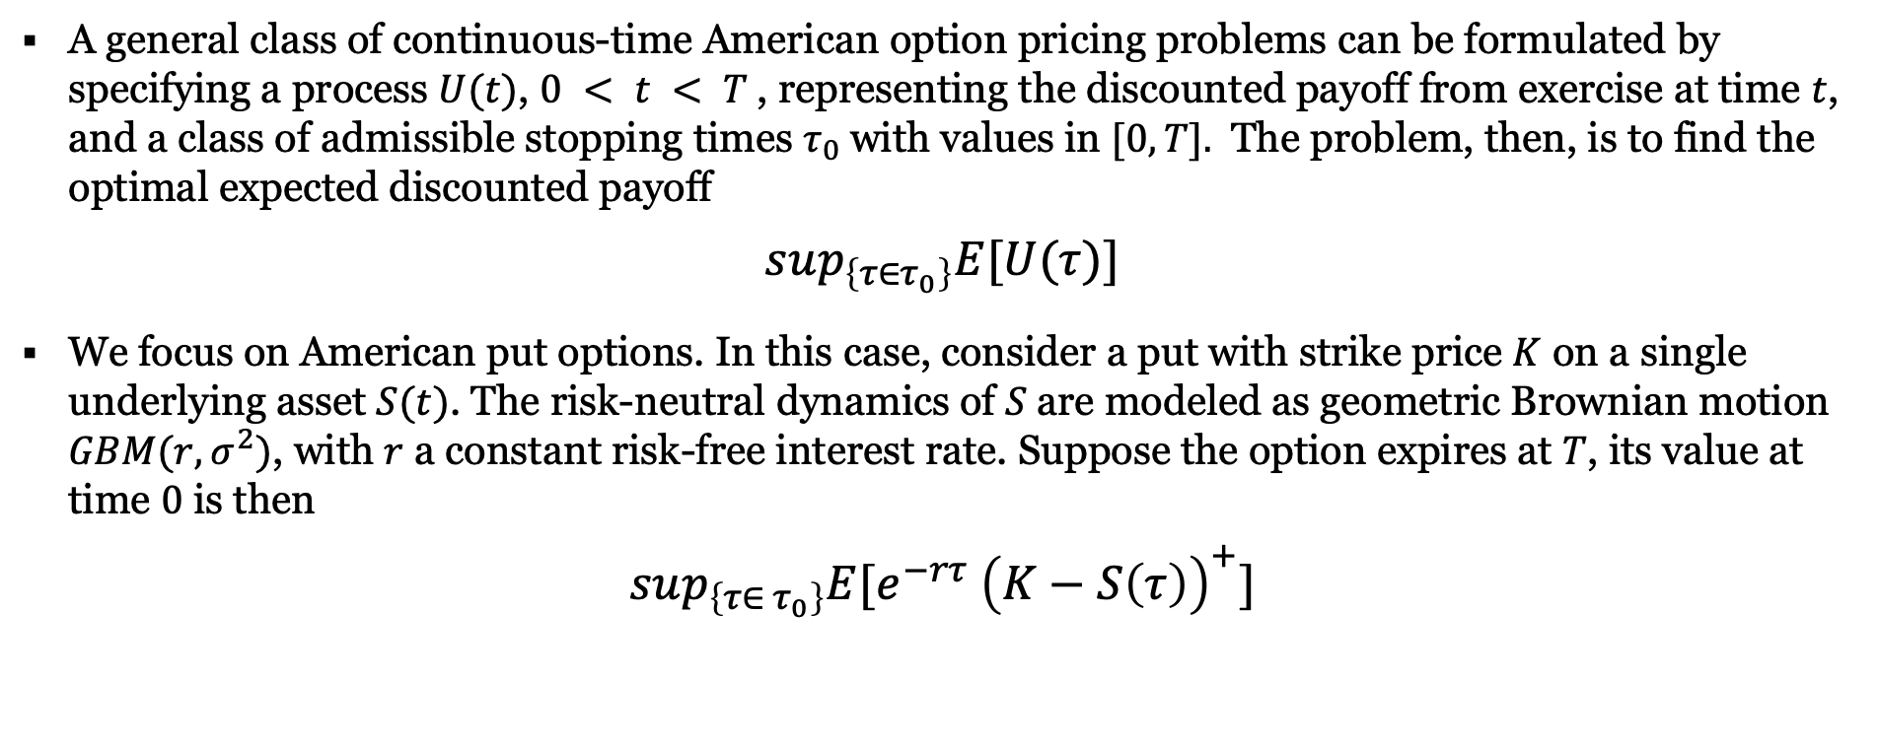
American option
OVERVIEW
A general class of continuous-time American option pricing problems can be formulated by specifying a process $U(t)$, $0 < t < T$, representing the discounted payoff from exercise at time $t$, and a class of admissible stopping times $τ_{0}$with values in $[0,T].$ The problem, then, is to find the optimal expected discounted payoff
$$sup_{\left\{τ∈τ_{0}\right\}}E[U(τ)]$$
We focus on American put options. In this case, consider a put with strike price $K$ on a single underlying asset $S(t)$. The risk-neutral dynamics of $S$are modeled as geometric Brownian motion $GBM(r,σ^{2})$, with $r$ a constant risk-free interest rate. Suppose the option expires at $T$, its value at time $0$ is then
$$sup_{\left\{τ∈ τ_{0}\right\}}E[e^{−rτ} {\left(K−S\left(τ\right)\right)}^{+}]$$

Slide 3
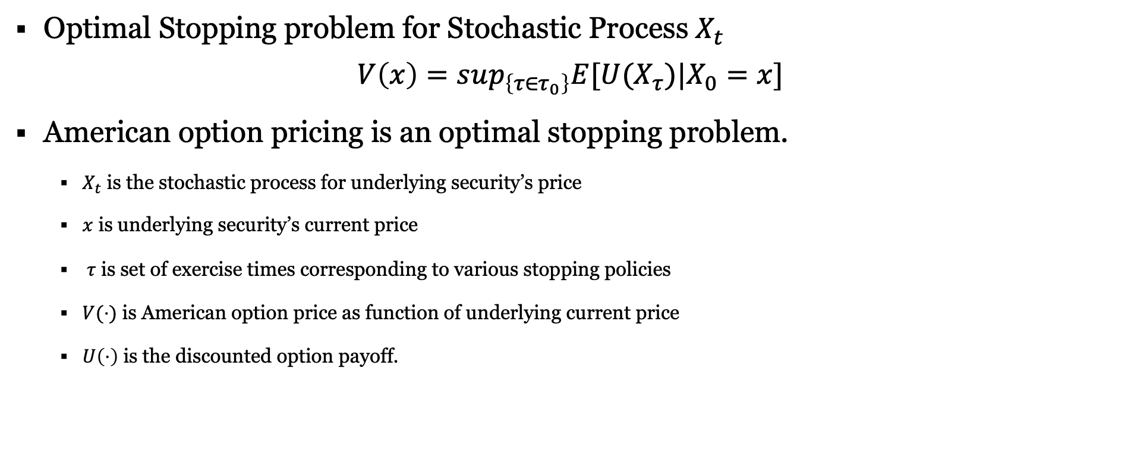
optimal stopping problem
OVERVIEW
Optimal Stopping problem for Stochastic Process $X_{t}$
$$V\left(x\right)=sup_{\left\{τ∈τ_{0}\right\}}E[U(X_{τ})|X_{0}=x]$$
American option pricing is an optimal stopping problem.
$X_{t}$ is the stochastic process for underlying security’s price
$x$ is underlying security’s current price
$τ$ is set of exercise times corresponding to various stopping policies
$V(⋅)$ is American option price as function of underlying current price
$U\left(⋅\right)$ is the discounted option payoff.

Slide 4
PRICE AMERICAN OPTIONS
OVERVIEW
Traditional ways
Black-Scholes: Due to the optimal stopping problem, this is technically impossible.
Lattice Tree(LT): Binomial or binary (recombining) tree pricing.
Finite difference(FD): solving the PDE with free boundary conditions.
Monte Carlo: Least Squares MC (LSM) model, etc.
Machine Learning methods
Gaussian Process Regression (GPR)
Lease Square Policy Iteration (LSPI)
Fitted Q-iteration (FQI)

Slide 5
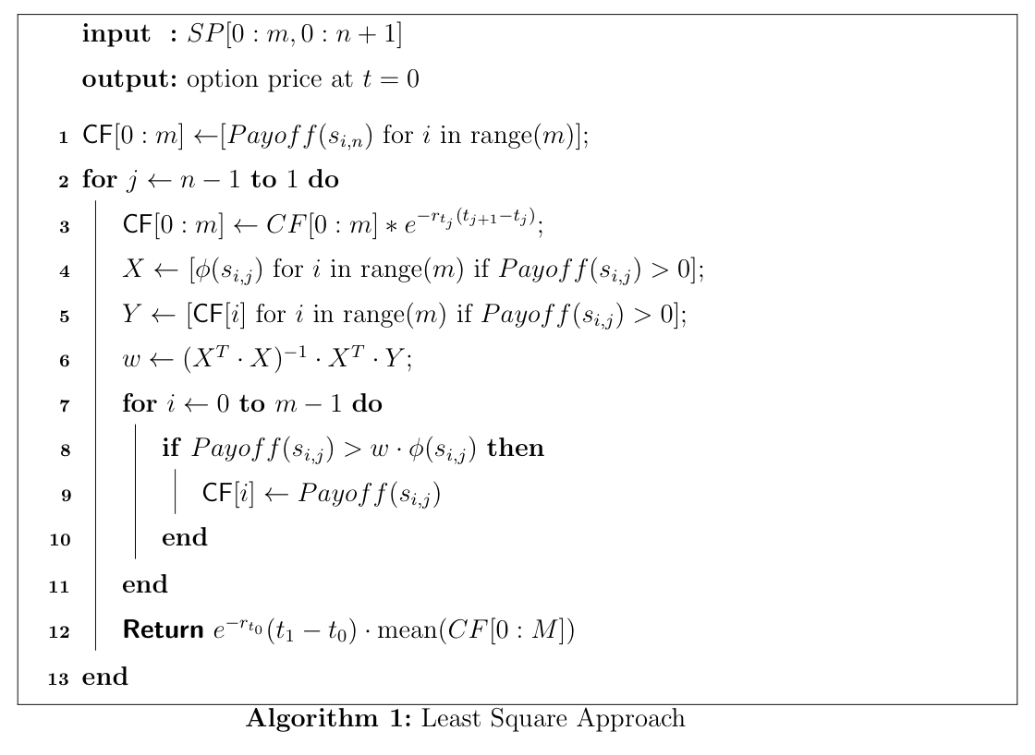
Least square approach
APPROACHES
Introduced and developed by Longstaff-Schwartz
Approximate the continuation value using a least square approach
the resulting price of the option is a lower bound on the option’s true price

Slide 6
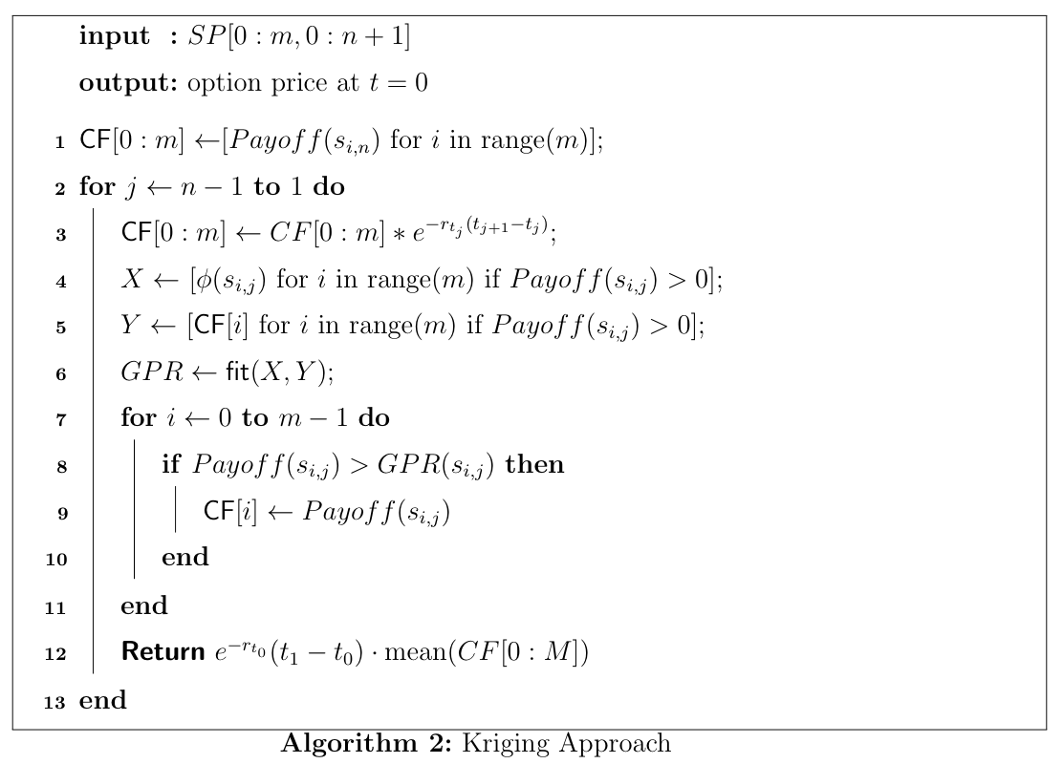
Gaussian process regression
APPROACHES
Proposed by Gang Mu, Teodor Godina, Antonio Maffia, Yong Chao Sun.
Approximate the continuation value using Gaussian process regression, instead of least square method.
The authors claim a lower standard errors than the LSM.

Slide 7
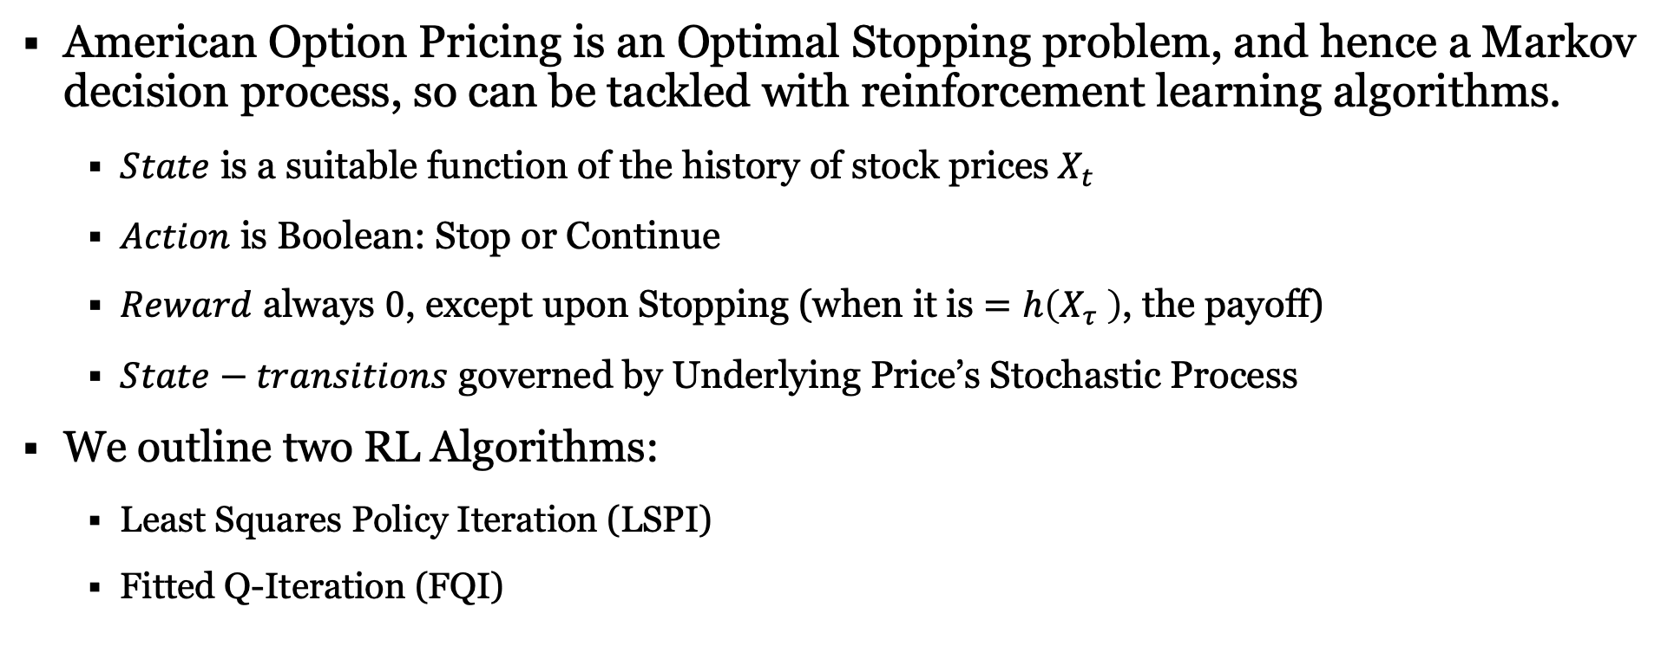
REINFORCEMENT LEARNING APPROACHES
APPROACHES
American Option Pricing is an Optimal Stopping problem, and hence a Markov decision process, so can be tackled with reinforcement learning algorithms.
$State$ is a suitable function of the history of stock prices $X_{t}$
$Action$ is Boolean: Stop or Continue
$Reward$ always $0$, except upon Stopping (when it is $=h\left(X_{τ} \right)$, the payoff)
$State−transitions$ governed by Underlying Price’s Stochastic Process
We outline two RL Algorithms:
Least Squares Policy Iteration (LSPI)
Fitted Q-Iteration (FQI)

Slide 8
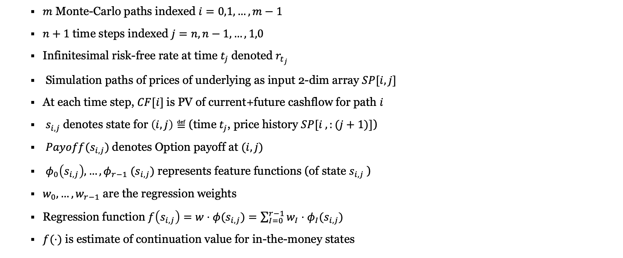
INGREDIENTS FOR approaches
APPROACHES
$m$ Monte-Carlo paths indexed $i=0,1,…,m−1$
$n+1$time steps indexed $j=n,n−1,…,1,0$
Infinitesimal risk-free rate at time $t_{j}$denoted $r_{t_{j}}$
Simulation paths of prices of underlying as input 2-dim array $SP[i,j]$
At each time step, $CF[i]$is PV of current+future cashflow for path $i$
$s_{i,j}$denotes state for $\left(i,j\right)≝$(time $t_{j}$, price history $SP[i ,:(j+1)]$)
$Payoff(s_{i,j})$denotes Option payoff at $(i,j)$
$φ_{0}\left(s_{i,j}\right),…,φ_{r−1} (s_{i,j})$ represents feature functions (of state $s_{i,j}$)
$w_{0},…,w_{r−1}$ are the regression weights
Regression function $f\left(s_{i,j}\right)=w⋅φ(s_{i,j})=\sum_{I=0}^{r−1}{w_{I}⋅φ_{I}(s_{i,j})}$
$f(⋅)$ is estimate of continuation value for in-the-money states

Slide 9
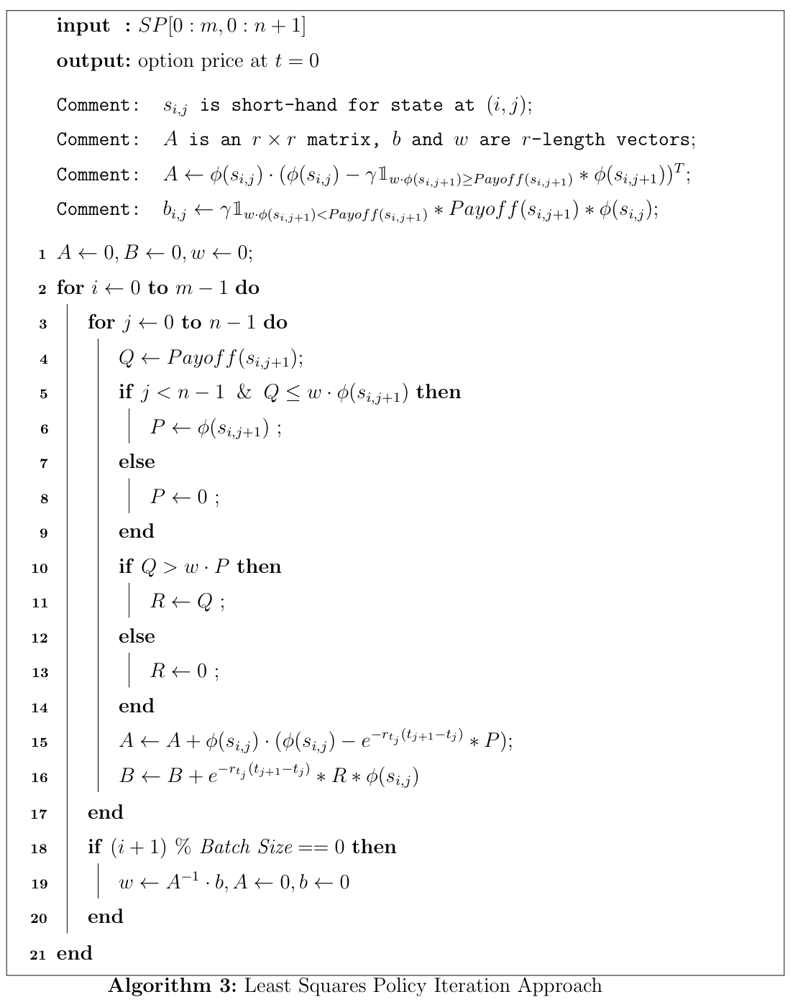
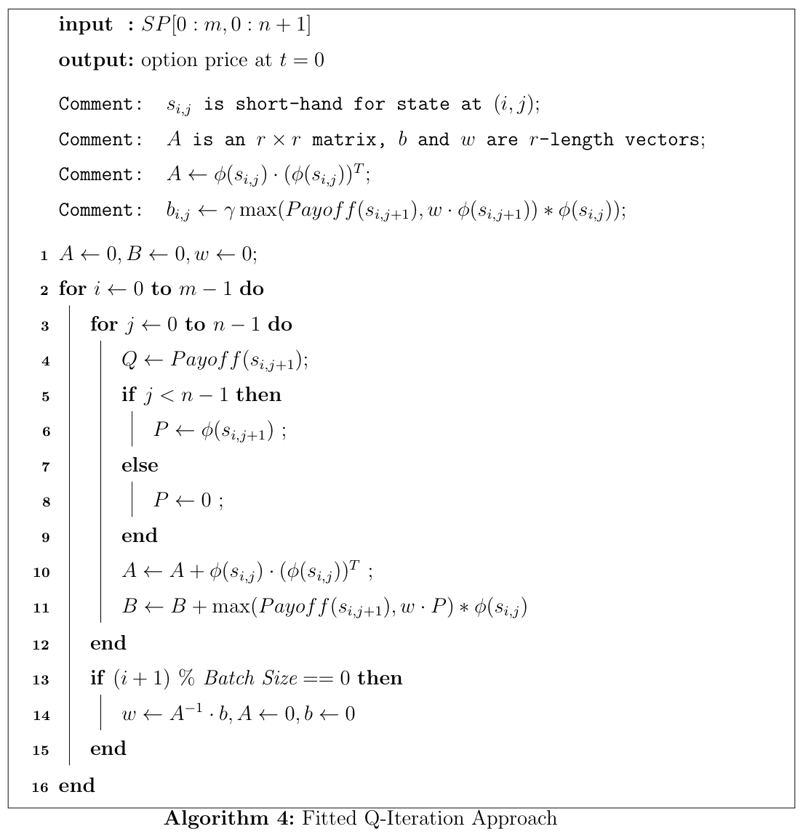
REINFORCEMENT LEARNING APPROACHES
APPROACHES

Slide 10
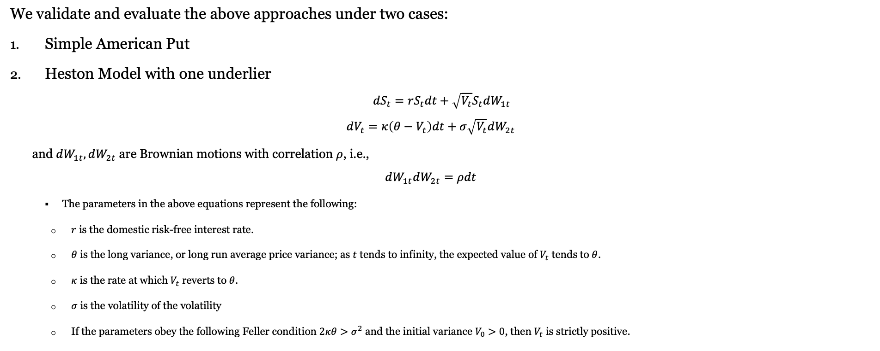
NUMERICAL EXAMPLES
EXPERIMENTS
We validate and evaluate the above approaches under two cases:
Simple American Put
Heston Model with one underlier
$$dS_{t}=rS_{t}dt+\sqrt{V_{t}}S_{t}dW_{1t}$$
$$dV_{t}=κ\left(θ−V_{t}\right)dt+σ\sqrt{V_{t}}dW_{2t}$$
and $dW_{1t},dW_{2t}$ are Brownian motions with correlation $ρ$, i.e.,
$$dW_{1t}dW_{2t}=ρdt$$
The parameters in the above equations represent the following:
$r$ is the domestic risk-free interest rate.
$θ$ is the long variance, or long run average price variance; as $t$ tends to infinity, the expected value of $V_{t}$ tends to $θ$.
$κ$ is the rate at which $V_{t}$ reverts to $θ$.
$σ$ is the volatility of the volatility
If the parameters obey the following Feller condition $2κθ>σ^{2}$ and the initial variance $V_{0}>0$, then $V_{t}$ is strictly positive.

Slide 11
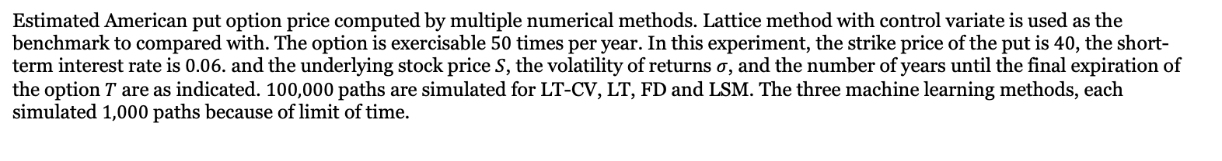
simple AMERICAN PUT
EXPERIMENTS
S | sigma | T | LT-CV | LT | FD | LSM | GPR | FQI | LSPI
36 | 0.2 | 1 | 4.4840 | 4.4845 | 4.4644 | 4.48 (0.02%) | 4.52 (0.87%) | 4.38 (-2.37%) | 4.37 (-2.53%)
 |  | 2 | 4.8501 | 4.8462 | 4.8288 | 4.83 (-0.31%) | 4.75 (-2.12%) | 4.85 (0.01%) | 4.79 (-1.15%)
 | 0.4 | 1 | 7.1098 | 7.0997 | 7.0765 | 7.09 (-0.21%) | 6.86 (-3.53%) | 6.87 (-3.39%) | 6.78 (-4.64%)
 |  | 2 | 8.5195 | 8.5079 | 8.4854 | 8.51 (-0.13%) | 7.93 (-6.95%) | 7.94 (-6.77%) | 8.22 (-3.56%)
38 | 0.2 | 1 | 3.2568 | 3.2529 | 3.2359 | 3.25 (-0.24%) | 3.19 (-2.08%) | 3.17 (-2.78%) | 3.01 (-7.46%)
 |  | 2 | 3.7540 | 3.7482 | 3.7336 | 3.74 (-0.26%) | 3.57 (-4.99%) | 3.57 (-4.90%) | 3.67 (-2.17%)
 | 0.4 | 1 | 6.1533 | 6.1805 | 6.1221 | 6.13 (-0.30%) | 6.16 (0.08%) | 5.89 (-4.28%) | 5.86 (-4.73%)
 |  | 2 | 7.6713 | 7.6891 | 7.6456 | 7.69 (0.20%) | 7.22 (-5.85%) | 6.89 (-10.13%) | 7.41 (-3.35%)
40 | 0.2 | 1 | 2.3245 | 2.3130 | 2.3004 | 2.31 (-0.58%) | 2.23 (-4.02%) | 2.25 (-3.08%) | 2.21 (-4.84%)
 |  | 2 | 2.8965 | 2.8851 | 2.8741 | 2.89 (-0.23%) | 2.69 (-7.25%) | 2.55 (-11.94%) | 2.77 (-4.21%)
 | 0.4 | 1 | 5.3260 | 5.3028 | 5.2865 | 5.32 (-0.21%) | 5.09 (-4.52%) | 5.08 (-4.68%) | 5.1 (-4.30%)
 |  | 2 | 6.9351 | 6.9137 | 6.8937 | 6.94 (0.04%) | 6.3 (-9.09%) | 6.86 (-1.06%) | 7.32 (5.51%)
42 | 0.2 | 1 | 1.6204 | 1.6239 | 1.6051 | 1.62 (-0.10%) | 1.54 (-4.97%) | 1.59 (-1.94%) | 1.6 (-1.13%)
 |  | 2 | 2.2187 | 2.2172 | 2.2029 | 2.23 (0.31%) | 2.08 (-6.27%) | 1.85 (-16.70%) | 2.06 (-7.24%)
 | 0.4 | 1 | 4.5884 | 4.6137 | 4.5578 | 4.59 (0.10%) | 4.22 (-8.00%) | 4.41 (-3.91%) | 4.43 (-3.36%)
 |  | 2 | 6.2464 | 6.2643 | 6.2200 | 6.27 (0.38%) | 5.85 (-6.31%) | 5.3 (-15.17%) | 5.96 (-4.63%)
44 | 0.2 | 1 | 1.1118 | 1.1212 | 1.1005 | 1.12 (0.30%) | 1.03 (-7.56%) | 1.13 (1.30%) | 1.09 (-1.82%)
 |  | 2 | 1.6921 | 1.6973 | 1.6816 | 1.69 (0.17%) | 1.46 (-13.49%) | 1.33 (-21.44%) | 1.47 (-13.36%)
 | 0.4 | 1 | 3.9529 | 3.9616 | 3.9243 | 3.96 (0.17%) | 3.39 (-14.31%) | 3.86 (-2.29%) | 3.87 (-1.98%)
 |  | 2 | 5.6511 | 5.6516 | 5.6158 | 5.67 (0.26%) | 4.57 (-19.05%) | 4.64 (-17.83%) | 5.29 (-6.41%)
Estimated American put option price computed by multiple numerical methods. Lattice method with control variate is used as the benchmark to compared with. The option is exercisable $50$ times per year. In this experiment, the strike price of the put is $40$, the short-term interest rate is $0.06$. and the underlying stock price $S$, the volatility of returns $σ$, and the number of years until the final expiration of the option $T$ are as indicated. $100,000$paths are simulated for LT-CV, LT, FD and LSM. The three machine learning methods, each simulated $1,000$ paths because of limit of time.

Slide 12
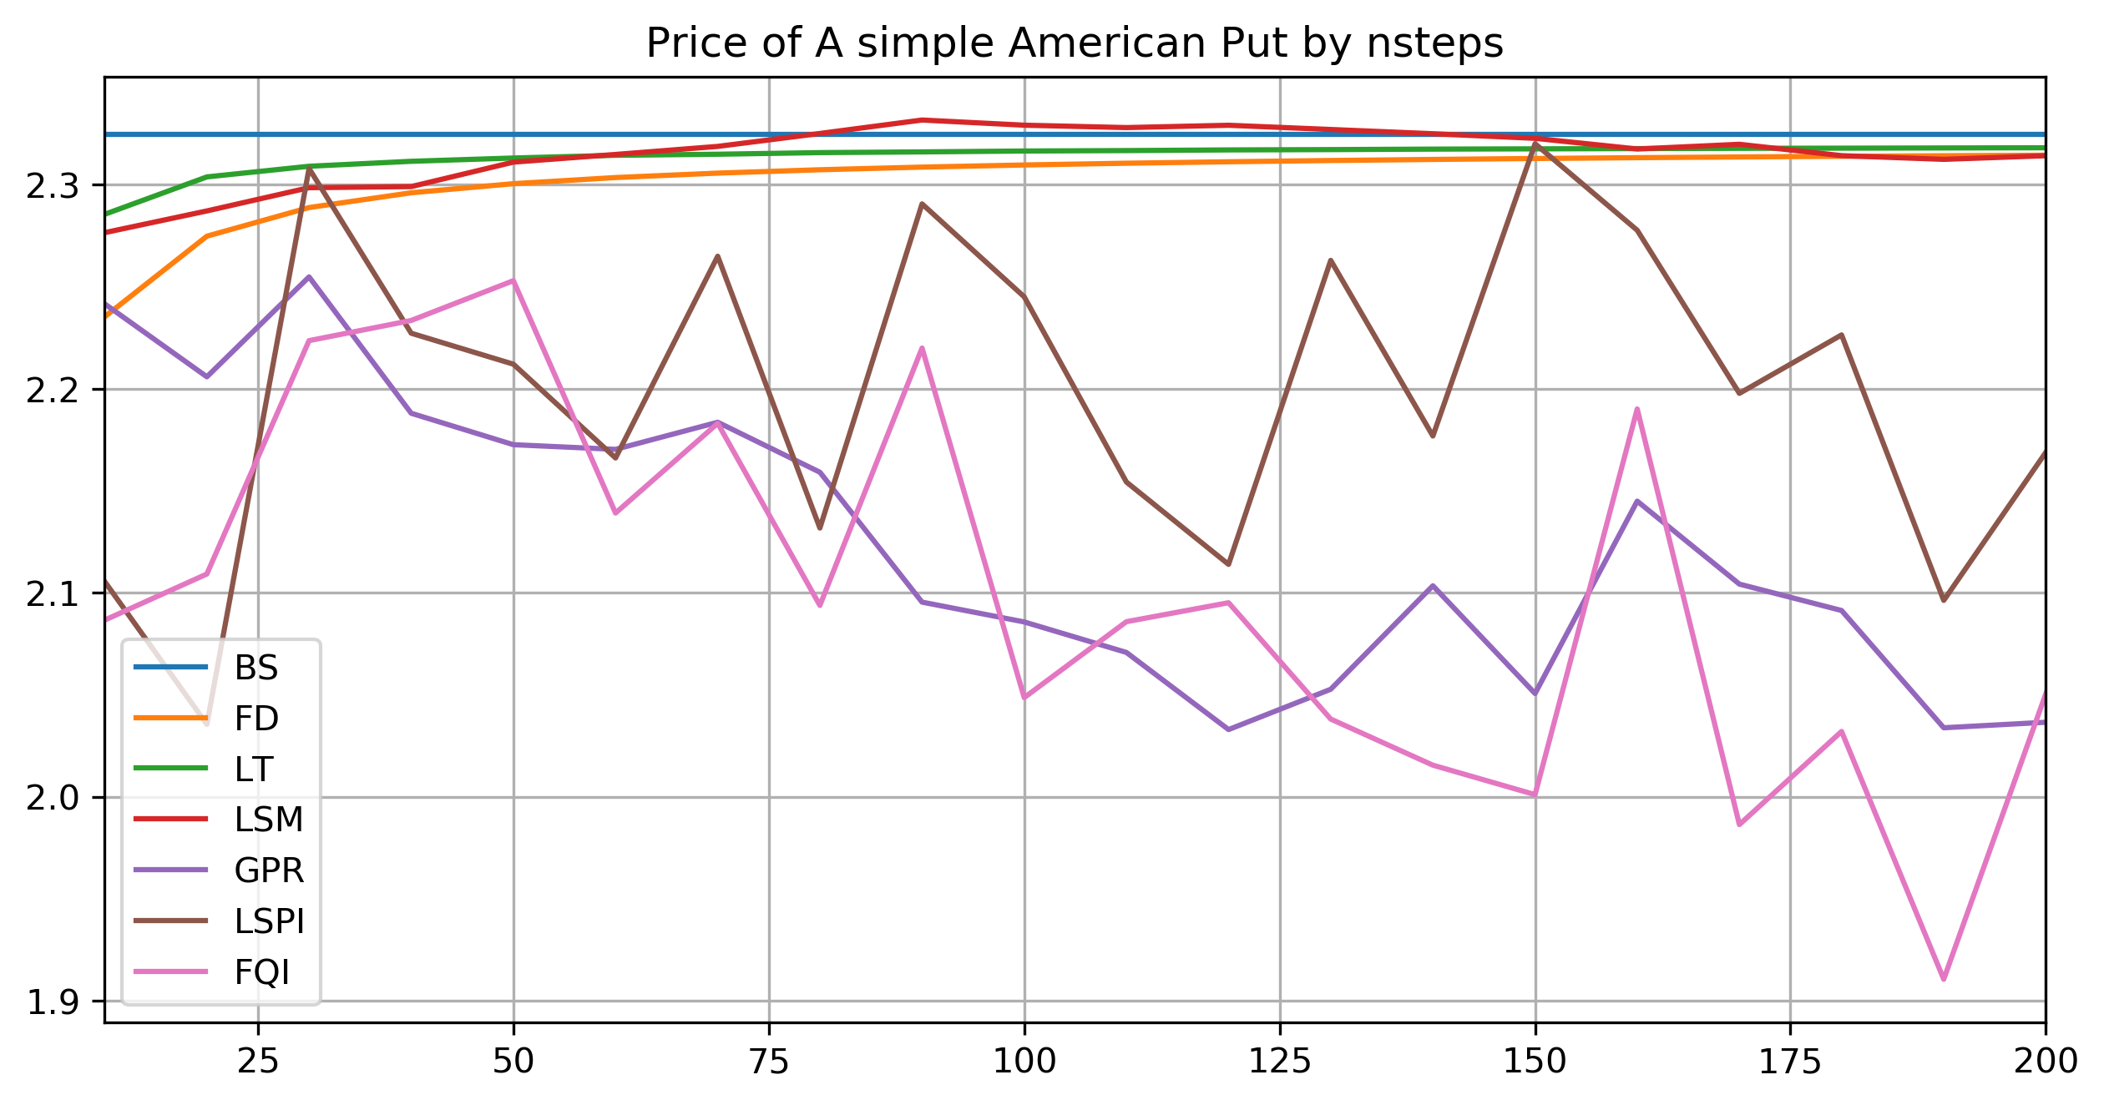
simple AMERICAN PUT
EXPERIMENTS
$$S_{0}=40,σ=0.2,T=1$$

Slide 13
simple AMERICAN PUT
EXPERIMENTS
S | sigma | T | GPR | FQI | LSPI | LSM
36 | 0.2 | 1 | 0.0966 | 0.0455 | 0.1527 | 0.7777
 |  | 2 | 0.1195 | 0.0261 | 0.0416 | 0.6849
 | 0.4 | 1 | 0.1926 | 0.3042 | 0.4242 | 0.5161
 |  | 2 | 0.2980 | 0.6438 | 1.1146 | 0.6494
38 | 0.2 | 1 | 0.0852 | 0.2275 | 0.2124 | 0.1770
 |  | 2 | 0.1450 | 0.1178 | 0.2959 | 0.1332
 | 0.4 | 1 | 0.2167 | 0.9136 | 1.0117 | 0.1291
 |  | 2 | 0.2233 | 0.8447 | 0.9468 | 0.3068
40 | 0.2 | 1 | 0.0766 | 1.5490 | 1.2054 | 0.2250
 |  | 2 | 0.1114 | 0.9847 | 0.9639 | 0.2112
 | 0.4 | 1 | 0.1771 | 0.4988 | 0.7561 | 0.2251
 |  | 2 | 0.2447 | 1.0665 | 1.2114 | 0.0274
42 | 0.2 | 1 | 0.0666 | 0.0905 | 0.3514 | 0.4079
 |  | 2 | 0.0959 | 0.5022 | 0.5380 | 0.4005
 | 0.4 | 1 | 0.1805 | 0.9311 | 0.8266 | 0.4738
 |  | 2 | 0.2010 | 0.5504 | 1.0005 | 0.2225
44 | 0.2 | 1 | 0.0522 | 0.4689 | 0.4798 | 0.4732
 |  | 2 | 0.0966 | 0.3125 | 0.4816 | 0.5238
 | 0.4 | 1 | 0.1943 | 0.6032 | 0.7278 | 0.6419
 |  | 2 | 0.2926 | 0.0931 | 0.5602 | 0.4323
Standard deviation by $50$ independent runs each.

Slide 14
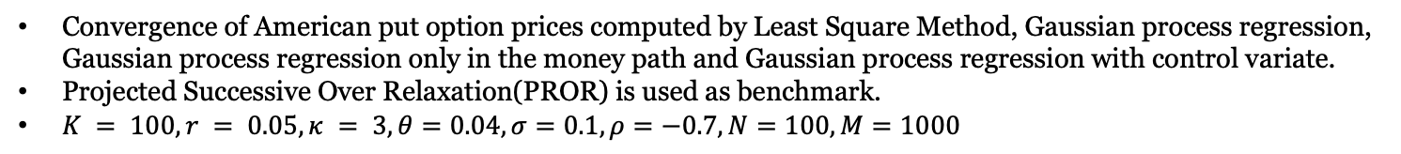
Heston model – one underlier
EXPERIMENTS
S0 | sigma | T | PSOR | LSM | GPR | GPR_IM | GPR_CV
90 | 0.04 | 0.25 | 10.1229 | 10.76 (6.27%) | 10.62 (4.88%) | 10.25 (1.30%) | 10.03 (-0.89%)
 |  | 0.5 | 10.5667 | 10.9 (3.19%) | 10.38 (-1.79%) | 10.41 (-1.47%) | 9.86 (-6.67%)
 | 0.09 | 0.25 | 10.9573 | 11.5 (4.98%) | 10.88 (-0.73%) | 10.81 (-1.39%) | 10.01 (-8.67%)
 |  | 0.5 | 11.7658 | 11.88 (0.99%) | 11.58 (-1.61%) | 11.51 (-2.14%) | 9.92 (-15.66%)
 | 0.16 | 0.25 | 12.1200 | 12.22 (0.79%) | 11.53 (-4.90%) | 11.11 (-8.31%) | 9.92 (-18.16%)
 |  | 0.5 | 13.2329 | 14.2 (7.34%) | 12.07 (-8.77%) | 12.02 (-9.15%) | 10.07 (-23.93%)
100 | 0.04 | 0.25 | 3.4813 | 3.61 (3.60%) | 3.4 (-2.37%) | 3.72 (6.72%) | 0.96 (-72.44%)
 |  | 0.5 | 4.6645 | 5.13 (9.99%) | 3.8 (-18.54%) | 5.05 (8.29%) | 0.86 (-81.56%)
 | 0.09 | 0.25 | 4.4961 | 5.23 (16.22%) | 3.93 (-12.68%) | 4.78 (6.27%) | 1.68 (-62.68%)
 |  | 0.5 | 6.2573 | 6.56 (4.80%) | 5.3 (-15.34%) | 5.99 (-4.23%) | 2.73 (-56.41%)
 | 0.16 | 0.25 | 6.4933 | 6.69 (3.06%) | 5.25 (-19.21%) | 5.98 (-7.84%) | 2.39 (-63.19%)
 |  | 0.5 | 8.0073 | 8.11 (1.25%) | 6.39 (-20.25%) | 7.21 (-9.92%) | 3.7 (-53.82%)
110 | 0.04 | 0.25 | 0.8417 | 0.88 (5.04%) | 0.76 (-9.14%) |  | 0 (-99.54%)
 |  | 0.5 | 1.7875 | 1.41 (-20.91%) | 1.14 (-36.11%) |  | 0.13 (-92.73%)
 | 0.09 | 0.25 | 1.8641 | 1.55 (-17.08%) | 1.27 (-31.81%) |  | 0.06 (-97.00%)
 |  | 0.5 | 3.0673 | 2.66 (-13.20%) | 2.07 (-32.54%) |  | 0.04 (-98.76%)
 | 0.16 | 0.25 | 3.1470 | 3.47 (10.33%) | 2.32 (-26.34%) |  | 0.05 (-98.40%)
 |  | 0.5 | 4.6232 | 4.9 (5.90%) | 3.48 (-24.64%) |  | 0.72 (-84.43%)
Convergence of American put option prices computed by Least Square Method, Gaussian process regression, Gaussian process regression only in the money path and Gaussian process regression with control variate.
Projected Successive Over Relaxation(PROR) is used as benchmark.
$K = 100, r = 0.05, κ = 3, θ=0.04,σ=0.1,ρ=−0.7,N=100,M=1000$

Slide 15
Heston model – one underlier
EXPERIMENTS
$$S_{0}=100,V_{0}=0.09,T=0.25$$

Slide 16
Summary
In this project, several numerical methods for American option pricing have been studied, namely the least square method, the Gaussian process regression approach, Least square policy iteration and Fitted Q-iteration method.
The LSM is the best among all by accuracy and computational time.
GPR performs different from what the original paper states, especially when it is with control variate.
LSPI and FPI performs fair enough, which is better than GPR but worse than LSM in both accuracy and running time.
The machine learning techniques has a fluctuated estimation as time step increases, while the LSM converge quick to a fixed value.
In terms of simulation error, LSM is the best. LSPI the second and then FQI. GPR is the worst.

Slide 17
FUTURE WORK
Use low-discrepancy points to reduce variance.
Try other regression models rather than Gaussian process regression, for example ANN. Discussed with Danny and Victor, they have some inspiring results.
The LSM is more suitable for multi-dimension problems according to Professor Adam. May test the performance of different approaches under multi-dimensional cases, for example, American max call on multiple assets.

Slide 18
REFERENCES
Longstaff, F. A., & Schwartz, E. S. (2001). Valuing American options by simulation: a simple least-squares approach. The review of financial studies, 14(1), 113-147.
Mu, G., Godina, T., Maffia, A., & Sun, Y. C. (2018). Supervised Machine Learning with Control Variates for American Option Pricing. Foundations of Computing and Decision Sciences, 43(3), 207-217.
Li, Y., Szepesvari, C., & Schuurmans, D. (2009, April). Learning exercise policies for american options. In Artificial Intelligence and Statistics (pp. 352-359).
Schwartz, E. S. (1977). The valuation of warrants: Implementing a new approach. Journal of Financial Economics, 4(1), 79-93.
MacMillan, L. W. (1986). Analytic approximation for the American put option. Advances in futures and options research, 1(1), 119-139.
Ludkovski, M. (2018). Kriging metamodels and experimental design for Bermudan option pricing.
Kamrad, B., & Ritchken, P. (1991). Multinomial approximating models for options with k state variables. Management science, 37(12), 1640-1652.
Glasserman, P. (2013). Monte Carlo methods in financial engineering (Vol. 53). Springer Science & Business Media.
Cassimon, D., Engelen, P. J., Thomassen, L., & Van Wouwe, M. (2007). Closed-form valuation of American call options on stocks paying multiple dividends. Finance Research Letters, 4(1), 33-48.

Slide 19
Thanks for listening

